Slide 1
Suicide Prevention Lesson Plan
School Based
Suicide Prevention:
An Overview
DEADLINE: March 1,2016
www.DirectingChange.org

Slide 2
Dear Adult Advisor,
Please use this presentation to provide youth with a few facts about mental health, suicide prevention, and the Directing Change film contest. This presentation is not intended to take the place of a comprehensive suicide prevention or mental health program.
This presentation will take between 20 and 45 minutes.
Review the content in this presentation and the links provided on the next slide for additional information you may want to include with this presentation.
Before proceeding with introducing the youth you work with to this material, be sure that you are familiar with the referral process on campus or resources in your community in case you need support for a youth at risk or for yourself. Talking about suicide doesn’t cause it to happen, but talking about suicide may bring thoughts that were already in place to the surface.
This slide and the next (slides 1-5) are intended for you, the advisor. When you present this to youth, begin on slide 6.
2

Slide 3
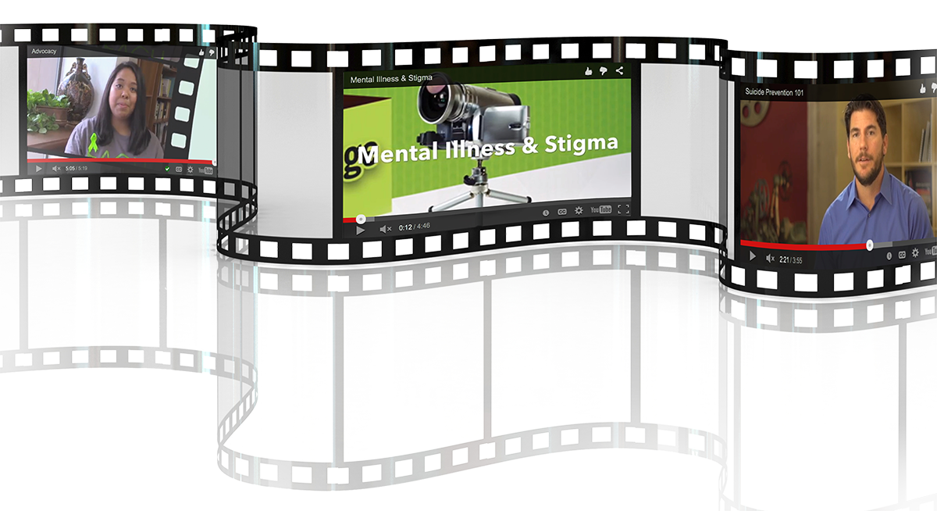
Resources for Presentation (Mental Health & Suicide Prevention)
The following educational videos give an overview of mental health, mental illness, and the stigma surrounding mental illness and are available on the Directing Change website. The topics that are discussed may be helpful when creating your films.
How to Help a Friend
Suicide Prevention 101
Mental Health Continuum
Mental Illness and Stigma
Mental Health Conditions
Advocacy
Suicide Prevention Lesson Plan and accompanying PowerPoint presentation, as well as trainings to support your school with developing or improving existing policies and programs to meet the requirements of this new legislation are available on the website (See the For Schools page).
The following fact sheets provide information on Suicide Prevention and Mental Health that may be helpful when creating the content and messaging for your films. They can be found on the Directing Change website.
Suicide Prevention Fact Sheet
Mental Health Fact Sheet
How to Help a Friend
3

Slide 4
Lesson #1- Recognizing Warning Signs and Offering Help
Objectives: (1) Students will understand warning signs of suicide and how to recognize them
(2) Students will be able to identify a trusted adult they will turn to for support
Time: 45-60 minutes
Materials: Access to computer and large screen/projector to project PowerPoint presentation
Access to internet to access educational films
.
4

Slide 5
Introduction
Explain that today we are learning about recognizing warning signs of suicide and how to appropriately respond to a friend or family member who may need help.
5

Slide 6
Youth and Young Adult
Presentation
School Based
Suicide Prevention:
An Overview
The information about
suicide prevention and
mental health contained in this presentation is consistent with best practices and reviewed by experts in the field.
DEADLINE: March 1,2016
www.DirectingChange.org

Slide 7
Please Take Care of Yourself
Mental health and suicide prevention are delicate topics.
Emotions may rise to the surface for you during or after this presentation.
Please make taking care of yourself during and after the presentation a priority.
If you need support, or help with a friend, please reach out to your teacher, counselor or other school resource.
You can also contact the following resources.
If you or someone you know needs support, please contact:
Call: (310)855-4673
(6pm-10pm daily)
Text “TEEN” to 839863
(6-9pm daily)
TeenLineOnline.org
Call or Text or visit: 988lifeline.org (chat)
7

Slide 8
The lives of youth
Have you ever heard an adult say, “What do you have to be stressed about? You’re just a kid.”
The reality is life as a teenager can be very difficult. Your life moves and changes very fast.
Although people often feel like they are the only ones with these problems, the truth is many other youth are struggling with similar issues and there is help available.
8

Slide 9
Friends trust friends
Who would be the first person you told if you got into a fight with your parents?
Who is the first person you would call if you got “dumped” by your boyfriend or girlfriend?
Has one of your friends ever told you something that they wouldn’t tell anyone else?
9

Slide 10
The more you know
Youth know more about what is going on in their friends’ lives than anyone else.
This puts you in the best position to know if one of your friends needs help.
People need to know what to look for and what to do if one of their friends needs help. That is why it is so important for everyone to know the warning signs for suicide, and how to support a friend.
10

Slide 11
Engage
Ask students to suggest behaviors they might observe in a friend who may be thinking about suicide. Write their suggestions on the white board.
11
Notes:
2) Go through slides 9 through 14 and talk about warning signs for suicide and how to offer support to a friend that is thinking about suicide.

Slide 12
Suicide Prevention:
Warning Signs and How to Help a Friend
12

Slide 13
Youth Warning Signs
Warning signs are indications that someone may be in danger of suicide, either immediately or in the near future.
Most people show one or more warning signs, so it is important to know the signs and take them seriously especially if a behavior is new or has increased and if it seems related to a painful event, loss, or change.
13

Slide 14
Warning Signs
Talking about or making plans for suicide.
Expressing hopelessness about the future.
Displaying severe/overwhelming emotional pain or distress.
Showing worrisome behavioral cues or marked changes in behavior, particularly in the presence of the warning signs above. Specifically, this includes significant:
Withdrawal from or changing in social connections/situations
Changes in sleep (increased or decreased)
Anger or hostility that seems out of character or out of context
Recent increased agitation or irritability
14

Slide 15
Warning Signs
The following life problems are associated with suicide risk, but if these are present in a person’s life it doesn't mean that person is definitely thinking about suicide. Life problems can put somebody more at risk for suicide, or may just mean that a person is struggling and needs help.
Difficulty dealing with stressful life circumstances:
Break-up of a romance or friendship
Parents’divorce, or problems in parent-child relationship
Mental health condition like depression and/or substance abuse, especially if untreated or undiagnosed
Death of a loved one or friend, especially if by suicide
Physical, sexual, or emotional abuse
Bullying or discrimination
Problems at school or work
15

Slide 16
Warning Signs
If you know someone who has any of the warning signs, there are things that you can do to help:
Ask them if they are okay and if they are having thoughts of suicide then listen to them like a true friend.
Tell them you are worried and concerned about them and that they are not alone.
Talk to an adult you trust about your concerns
16

Slide 17
Warning Signs
Suicide needs to be taken seriously every time, and adults need to know.
You may think that you and your friends can get through anything together but when suicide is involved, adults need to know.
There are good people who can help…a teacher…a counselor…a coach…a parent.
If an adult is not available, immediately call the 988 Suicide & Crisis Lifeline
Remember, if anyone is harming themselves now or has just harmed themselves, call 911 or take them to an emergency room immediately.
17

Slide 18
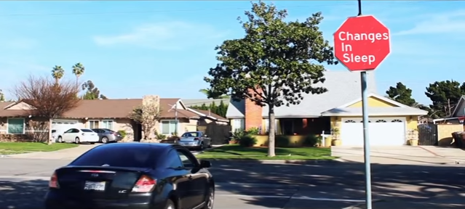
Tell an adult
Show Directing Change film “Signs” about warning signs:
Signs
18
Notes:
“Signs”: https://www.youtube.com/watch?v=JntB4ah4cF8%20

Slide 19
Engage
Discussion Question: What warning signs were listed in this film?
19

Slide 20
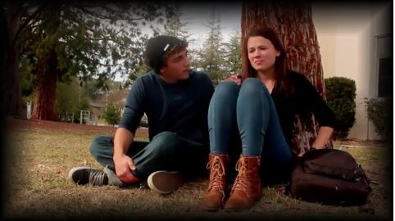
Engage
2. Show Directing Change film “A New Tomorrow” about warning signs and connecting a friend to help:
A New Tomorrow
20
Notes:
- “A New Tomorrow”: https://vimeo.com/92755069

Slide 21
Engage
• Discussion Question: How did the friend connect the person to help?
• Discussion Question: Research shows that 60-80% of young people tell a friend that they are thinking about suicide, but less than 25% of those friends go on to seek help for that person.
o Why do you think only ¼ of those friends tell an adult?
o Would you keep something a friend told you a secret? Why?
21

Slide 22
Do/Experience
Implement one or both of these two activities (optional).
Activity #1: Spot the Change Game
Activity #2: Tell a Trusted Adult
22

Slide 23
ACTIVITY #1: DO/EXPERIENCE Spot the Change Game
Request 3 to 4 volunteers and have the rest of the class take a close look at them.
Ask the volunteers to leave the classroom and change something about their appearance.* Examples would be: pulling out their pockets, remove an earring, taking off glasses, tucking in or untucking shirt.
When the volunteers return, ask class to spot the changes.
Link spotting the change in friends to warning signs and how we recognize them.**
Discussion Question: How would you notice the difference in yourself or your friends?
Sometimes the changes are not that visible or we don’t feel safe sharing. So often when someone asks us how we are doing, we say “…fine” when we really might be meaning, I am feeling depressed, sad, alone, hurt, confused, unloved, misunderstood, insignificant, broken, hopeless.
Ask: If you are worried for a friend or yourself, who can you turn to? Can you name three trusted adults that you could go to if you or your friend needed help?
*If this activity is being held virtually, have the students go into a virtual breakout room with an adult (if possible) and have them change one thing about their appearance that can be seen on a webcam (e.g., from the head to mid-torso)
** This activity can also be done via a social media post. Have students change something about a photo that is posted or part of a caption. What changed? What might be a sign that you should check in on your friend?
(Adapted from San Diego Youth Services “Here Now” Student Presentation)
23

Slide 24
ACTIVITY #2: DO/EXPERIENCE Identify a Trusted Adult
Ask students to write down the names of 2 people they can contact when they have good news to share.
Then ask students to write down the names of 2 people they can contact if they have bad news to share.
Then ask students to write down the names of 3 trusted adults (at home or at school) they can contact if a friend tells them they are thinking about suicide.
Ask: Why did you choose those 3 trusted adults. Ask students if the trusted adults are someone they know at home or at school? If they don’t have someone at home, or vice versa, ask them to think of one.
Inform students that you are a trusted adult who they can come to if they have a friend who is thinking about suicide or needs help.
Inform students that trusted adults can be family members, caregivers, family friends, teachers, counselors, coaches, clergy members, youth leaders, laws enforcement officers.
(Adapted from San Diego Youth Services “Here Now” Student Presentation)
24

Slide 25
Reflect
Ask students to share one thing they learned today about warning signs and supporting a friend that they did not know before the lesson began.
25

Slide 26
Apply
Explore how students might act in the following situations, helping them see how they might apply the knowledge from today’s lesson:
What would you do if you recognized warning signs in a friend?
Who would you tell if a friend told you they were thinking about suicide and asked you to promise not to tell anyone?
What would you say to the trusted adult?
Would you tell your friend who confided in you that you had told a trusted adult, even if they asked you to keep it a secret?
26
Notes:
(Note to Teacher: Students are apt to answer with responses they think that you may want to hear. Challenge them to consider what they really would or would not do if they were told not to break a friend’s trust and tell a secret. Help them to explore why doing the "right" thing might not always be so easy).

Slide 27
Additional Resources
• “All You Need is Words”: https://www.youtube.com/watch?v=NnQ1r_nuuXw
• “Hey Taylor”: https://vimeo.com/92755737
• “How to Help a Friend” Educational Video:
https://vimeo.com/464403017
• “Suicide Prevention 101” Educational Video: https://vimeo.com/464407220
27

Slide 28
To Participate
Review the contest rules.
Select a submission category
60-second Suicide Prevention film
30-second Animated Short (Suicide Prevention) film
60-second Mental Health film
60-second Through the Lens of Culture film
60-second Walk in Our Shoes film
60-second Hope and Justice film
Submit “Intent to Direct” form. This really helps us get an idea of how many submissions to expect and to get organized! (Only one entry per film team please- this should be the lead participant.)
Select a submission category and review the content guidelines.
Identify an adult advisor representing your school or organization.
Complete all release forms from every person who participated.
Upload your film and Submit an Entry Form to the Directing Change Portal by March 1 every year.
Follow us on Facebook!
28

Slide 29
School Presentation:
Mental Health
School Based
Suicide Prevention:
An Overview
DEADLINE: March 1,2016
www.DirectingChange.org

