Slide 1
School Presentation:
Mental Health
School Based
Suicide Prevention:
An Overview
DEADLINE: March 1,2016
www.DirectingChange.org

Slide 2
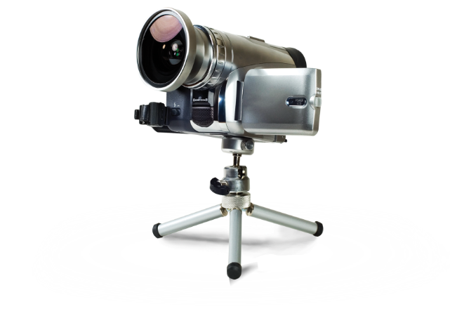
Dear Adult Advisor,
Please use this presentation to provide youth with a few facts about mental health, suicide prevention, and the Directing Change film contest. This presentation is not intended to take the place of a comprehensive suicide prevention or mental health program.
This presentation will take between 20 and 45 minutes.
Review the content in this presentation and the links provided on the next slide for additional information you may want to include with this presentation.
Before proceeding with introducing the youth you work with to this material, be sure that you are familiar with the referral process on campus or resources in your community in case you need support for a youth at risk or for yourself. Talking about suicide doesn’t cause it to happen, but talking about suicide may bring thoughts that were already in place to the surface.
This slide and the next (slides 1-6) are intended for you, the advisor. When you present this to youth, begin on slide 7.
2

Slide 3
Resources for Presentation (Mental Health)
The following websites can assist you in preparing to discuss how you and your students can help eliminate the stigma associated with mental illness.
Take Action 4 Mental Health
As part of California’s ongoing mental health movement, the Take Action for Mental Health campaign is designed to help you check in, learn more, and get support for your own mental health or the mental health of someone you care about.
www.Takeaction4mh.com
National Alliance for Mental Illness (NAMI)
NAMI is a national non-profit organization focused on advocacy for mental health, and providing programs and resources for people living with mental illness and their families. The website offers information about their programs and the topic of mental health.
Request an “Ending the Silence” Presentation for your classroom.
Contact your local NAMI affiliate and request an “In Your Own Voice” presentation at your class, from people who are experiencing a mental illness.
www.namicalifornia.org
3

Slide 4
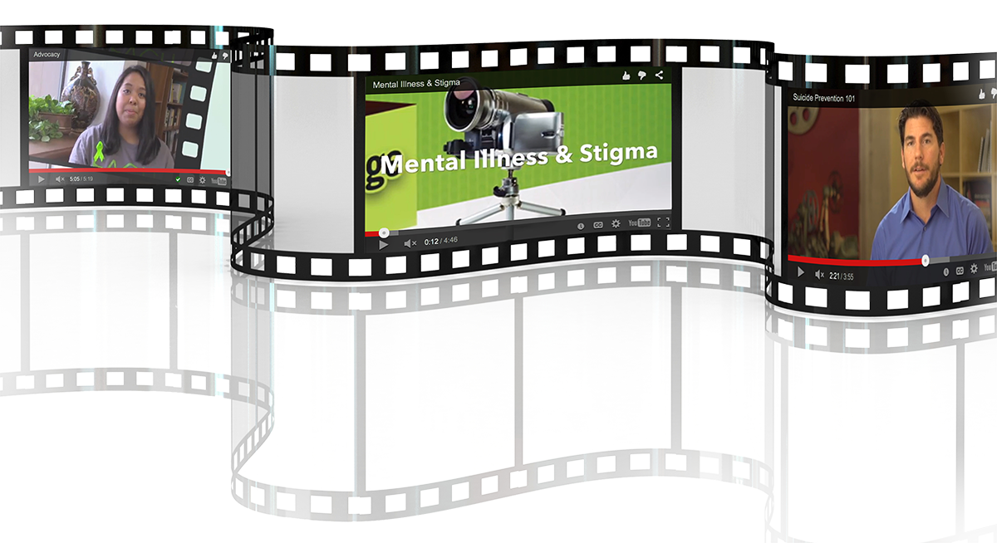
Resources for Presentation (Mental Health & Suicide Prevention)
The following educational videos give an overview of mental health, mental illness, and the stigma surrounding mental illness and are available on the Directing Change website. The topics that are discussed may be helpful when creating your films.
How to Help a Friend
Suicide Prevention 101
Mental Health Continuum
Mental Illness and Stigma
Mental Health Conditions
Advocacy
Suicide Prevention Lesson Plan and accompanying PowerPoint presentation, as well as trainings to support your school with developing or improving existing policies and programs to meet the requirements of this new legislation are available on the website (See the For Schools page).
The following fact sheets provide information on Suicide Prevention and Mental Health that may be helpful when creating the content and messaging for your films. They can be found on the Directing Change website.
Suicide Prevention Fact Sheet
Mental Health Fact Sheet
How to Help a Friend
4

Slide 5
Examples of films
Student Examples (Mental Health Matters- Directing Change Statewide Winners):
“If We All Speak Loud Enough” First Place
- http://vimeo.com/92756723
“Hurdles” Third Place
- https://vimeo.com/124879446
“Identity” First Place
https://youtu.be/Ky63Chga9aw
“Circling Stigma” First Place
- https://vimeo.com/93165304
Note: These films exemplify great messaging and how to explore these topics in a creative way. “Hurdles” is a great example of a creative way to show how friends can support one another. “Make a Ripple” reminds us that we are not defined by our mental health challenges and it is ok to reach out for support from friends, family and teachers.
5

Slide 6
Examples of films
Student Examples (Through the Lens of Culture):
“隠された思い (My Hidden Feelings)” First Place
- https://www.youtube.com/watch?v=aTRqBfKvH1g&feature=youtu.be
“My Friend Tyler” Third Place
- https://vimeo.com/124879446
“Suicide on Indian Country” Third Place
https://www.youtube.com/watch?v=8EgOpiLwABQ&feature=youtu.be
“Caged Bird” First Place
- https://youtu.be/4HBqGO2XGFw
If you are going to attempt to make a film from the perspective of arts or dance culture (or something similar), it is not enough to show people creating art or dancing in your film; take it a step further and demonstrate how being part of these cultures can influence young people’s thoughts about suicide and mental health, getting help, offering support and standing up for others.
6
Notes:
Tip! This is a very competitive category and we encourage you to view some of the films that were submitted last year. For your film to score high, it is important to connect culture with suicide prevention and mental health and to explore how the culture you chose to focus on influences openly talking about these topics among friends and family members, seeking help and supporting others. For example, it is great to create a film in Spanish, Chinese or using sign language, but take it a step further and focus on cultural perspectives, cultural strengths, or cultural practices that might encourage people who are part of that culture to seek help or show how loved ones can support someone in distress. If you are going to attempt to make a film from the perspective of arts or dance culture (or something similar), it is not enough to show people creating art or dancing in your film; take it a step further and demonstrate how being part of these cultures can influence young people’s thoughts about suicide and mental health, getting help, offering support and standing up for others.
Note: These films are all statewide winners in the Through the Lens of Culture category. Young film makers are encouraged to explore the topics of suicide prevention and mental health through the lens of a particular culture. It is important to note that all of the submission requirements that are part of the Suicide Prevention Category and the Mental Health Matters categories still apply, but with an additional level of complexity and creativity focused on culture.

Slide 7
Youth and Young Adult
Presentation
School Based
Suicide Prevention:
An Overview
The information about
suicide prevention and
mental health contained in this presentation is consistent with best practices and reviewed by experts in the field.
DEADLINE: March 1,2016
www.DirectingChange.org

Slide 8
Please Take Care of Yourself
Mental health and suicide prevention are delicate topics.
Emotions may rise to the surface for you during or after this presentation.
Please make taking care of yourself during and after the presentation a priority.
If you need support, or help with a friend, please reach out to your teacher, counselor or other school resource.
You can also contact the following resources.
If you or someone you know needs support, please contact:
Call: (310)855-4673
(6pm-10pm daily)
Text “TEEN” to 839863
(6-9pm daily)
TeenLineOnline.org
Call or Text or visit: 988lifeline.org (chat)
8

Slide 9
The lives of youth
Have you ever heard an adult say, “What do you have to be stressed about? You’re just a kid.”
The reality is life as a teenager can be very difficult. Your life moves and changes very fast.
Although people often feel like they are the only ones with these problems, the truth is many other youth are struggling with similar issues and there is help available.
9

Slide 10
Friends trust friends
Who would be the first person you told if you got into a fight with your parents?
Who is the first person you would call if you got “dumped” by your boyfriend or girlfriend?
Has one of your friends ever told you something that they wouldn’t tell anyone else?
10

Slide 11
The more you know
Youth know more about what is going on in their friends’ lives than anyone else.
This puts you in the best position to know if one of your friends needs help.
People need to know what to look for and what to do if one of their friends needs help. That is why it is so important for everyone to know the warning signs for suicide, and how to support a friend.
11

Slide 12
Mental Health: Information and Category Description
12

Slide 13
What is Mental Health
Mental Health affects everyone, in every stage of life.
It is our emotional, psychological, and social well-being.
It affects how we think, feel, and act.
It helps determine how we handle stress, relate to others, and make choices.
Mental Health Continuum:
Everyone falls somewhere on the scale and our mental health can move anywhere on this spectrum throughout our life.
13

Slide 14
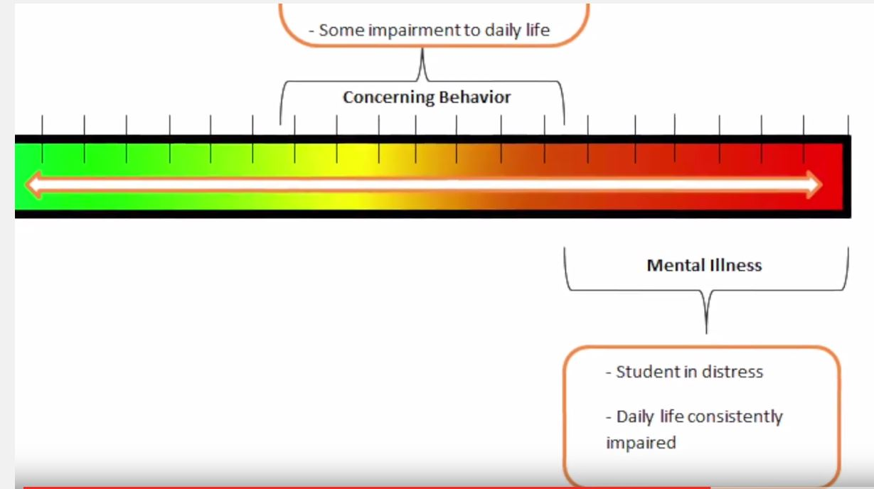
What is Mental Illness
Mental Illness is a medical condition that disrupts a person’s thinking, feeling, mood, ability to relate to others and daily functioning.
Often interferes with effectively coping with ordinary demands of life.
1 in 5 youth ages 13 to 18 experiences a mental health challenge.
70-80% of people report improved quality of life after receiving support and treatment.
Mental Health Continuum:
Serious mental illnesses impact daily life including going to school or work, relationships, and eating and sleeping patterns.
For more information visit: www.namica.org
14

Slide 15
Why is it important to seek help early?
Research shows that half of all mental illnesses start by age 14 and three-quarters start by age 24.
But, an average of 6 to 8 years passes after the symptoms of mental illness begin, before young people get help.
Without treatment, the frequency and severity of mental illness tends to increase over time.
15

Slide 16
Stigma
If waiting to get help means that symptoms of mental illness gets worse, then why do people wait?
Research tells us that the largest barrier to reaching out for mental health needs is stigma.
Stigma:
is a way of thinking that says that certain people are less deserving of our respect and leads to discrimination.
is a mark of disgrace that sets a person apart.
comes from negative and incorrect beliefs, or stereotypes, about groups of people.
The effects of stigma can make people feel sad, ashamed, hopeless, misrepresented or alone.
Stigma keeps people suffering in silence
16

Slide 17
How to Help a Friend of Family Member
If you’re concerned about a friend, talk to them and ask if they need help, then connect them with a trusted adult.
Show your support and listen. Express your concern and sympathy, talk openly and make sure that your friend or family member knows that he/she is not alone. The most important thing you can do is just offer to be available.
Ask what you can do to help. You can leave this open-ended (“I want to know how I can best support you.”) or suggest specific tasks that might be helpful (“Can I drive you to your appointment?”).
Reassure your friend or family member that you still care about him/her. Even if he/she doesn’t always feel like talking or spending time together, it can be a comfort just to know that he/she has friends that care.
Educate yourself about your friend or family member’s disorder. This can help you to know what to expect.
Support your friend or family member’s healthy behaviors.
17

Slide 18
Your Film Can Help Start Important Conversations to Show the Mental Health Matters
You can help break down stigma by learning more and sharing the truth about mental health through your film by:
Telling a story about how young people can support themselves or others living with a mental health challenge.
Consistently use person-first language, which refers to people who are living with mental health challenges as part of their full-life experience, not people who are defined by their mental health challenges (i.e. use she experiences depression, not she is depressed).
Communicating a message that is positive and hopeful.
Demonstrating how those in the youth age group (14-24) deal with themselves, peers, adults, or relatives having a mental illness.
You can help break down stigma by learning more and sharing the truth about mental health through your film by:
Telling a story about how young people can support themselves or others living with a mental health challenge.
Consistently use person-first language, which refers to people who are living with mental health challenges as part of their full-life experience, not people who are defined by their mental health challenges (i.e. use she experiences depression, not she is depressed).
Communicating a message that is positive and hopeful.
Demonstrating how those in the youth age group (14-24) deal with themselves, peers, adults, or relatives having a mental illness.
18

Slide 19
Your film should have a positive message of support, acceptance, hope, and/or recovery related to mental health challenges.
We are looking for stories about getting help, or how to support a friend or family member that is going through tough times.
Here are a few examples:
• Talk openly
• Stand up for others
• Be supportive
• Get the facts and understand the issue
• Don’t wait to get help
Note: The message does not have to be one of the messages above, as long as the
message encourages positive change, support or help-seeking. It does not have to
be stated verbatim, but could be implied through dialog or another creative way.
This may include interactions in online communities (i.e. Facebook, texts)
19
Notes:
Talk openly: The film can emphasize that it is acceptable to talk about mental health challenges, and to support friends and loved ones with such challenges.
Stand up for others: The film can demonstrate the importance of young people standing up for themselves or those living with a mental health challenge who are being harassed, bullied, and excluded or in some other way discriminated against. This may also include interactions in online communities (i.e. Facebook, Twitter, texting).
Be Supportive: Show ways in which friend or family members can support someone experiencing a mental health challenge.
Join the mental health movement: This is a young adult’s issue: mental health challenges most often show up between the ages of 14-24. The film could inspire young people across California to join the mental health movement.
Get the facts and understand the issue: The film could illustrate that a diagnosis of mental illness does not define a person and/or debunk the negative misconceptions about mental illness.
Don’t wait to get help: The film can let people know that there is help out there for people living with a mental illness. That treatment and support work and that most people who experience a mental health challenge can recover, especially if treated early.

Slide 20
Messaging
The Mental Health Matters category has special content that must be avoided.
Here are a few examples:
Do Not include derogatory language
Films cannot use terms like “crazy” and “psycho” without explicitly communicating to the audience that these terms are unacceptable.
If the film does not verbally communicate that using derogatory terms are unwelcomed, the film will be disqualified.
20

Slide 21
Your Mental Health Film Should:
Educate your peers that anyone can have a mental illness and/or that people who have a mental illness are more like me than different from me.
Encourage Action – Encourage the viewer to feel, act or think differently. Provide specific suggestions of where to get help, how to offer support to someone, or how to get involved or learn more information.
Be Positive and Hopeful – Your film should have a positive message of support, acceptance, hope and/or recovery related to mental health challenges. The good news about mental illness is that recovery is possible! With the appropriate help, those experiencing mental illness can live very fulfilling lives.
Use person-first language – Person first language respectfully puts the person before the illness and reinforces the idea that those who experience mental health challenges are not defined by their condition.
Use: Do not use:
I was diagnosed with bipolar disorder. I am bipolar.
She is experiencing a mental health challenge. She is mentally ill.
People living with mental health challenges. The mentally ill.
He has schizophrenia. He is schizophrenic.
She experiences symptoms of depression. She suffers from depression.
Be Relatable – Your film should be about young people (ages 14-25). The film does not have to solely focus on youth but youth need to have some kind of role or voice in the film.
21

Slide 22
Through the Lens of Culture: Information and Category Description
22

Slide 23
Through the Lens of Culture Category
Important Requirements for the Through the Lens of Culture Category
By submitting a film in the Through the Lens of Culture category young film makers are encouraged to explore the topics of suicide prevention and mental health through the lens of a particular culture. It is important to note that all of the submission requirements that are part of the Suicide Prevention Category and the Mental Health categories still apply, but with an additional level of complexity and creativity focused on culture.
More work? A greater challenge? Absolutely! But we offer a larger cash prize to sweeten the pot.
23

Slide 24
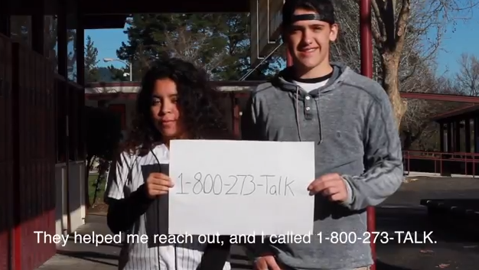
Through the Lens of Culture Category
Films must be 60-seconds in length (this includes the required end slate but does not include the required title slide)
All films need to include captioning. (Films are encouraged to be submitted in languages other than English, but all films in this category are required to include captioning, even if the film is in English.)
24

Slide 25
Through the Lens of Culture Category
Take action by creating a 30 or 60-second film to prevent suicide OR help change attitudes and behaviors surrounding mental illness and mental health.
Submission deadline: March 1 every year.
The contest and program is open to middle school and high school students and youth and young adults (between the ages of 12 and 25) associated with a college, university, club, or community-based organization.
No prior video production experience necessary!
Winning film teams and associated schools or organizations will receive cash prizes and will be recognized with additional prizes for their cinematic achievement at the award ceremony.
Visit: www.directingchangeca.org for contest rules,
tips and more information.
25

Slide 26
To Participate
Review the contest rules.
Select a submission category
60-second Suicide Prevention film
30-second Animated Short (Suicide Prevention) film
60-second Mental Health film
60-second Through the Lens of Culture film
60-second Walk in Our Shoes film
60-second Hope and Justice film
Submit “Intent to Direct” form. This really helps us get an idea of how many submissions to expect and to get organized! (Only one entry per film team please- this should be the lead participant.)
Select a submission category and review the content guidelines.
Identify an adult advisor representing your school or organization.
Complete all release forms from every person who participated.
Upload your film and Submit an Entry Form to the Directing Change Portal by March 1 every year.
Follow us on Facebook!
26

Slide 27
School Presentation:
Mental Health
School Based
Suicide Prevention:
An Overview
DEADLINE: March 1,2016
www.DirectingChange.org

